Slide 1
CONSULTING NINJAS
MGMT 59000
Client : Craigslist
7th December, 2022

Slide 2
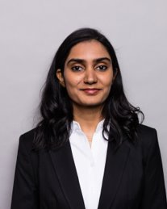
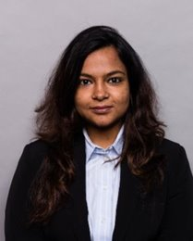
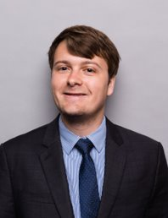
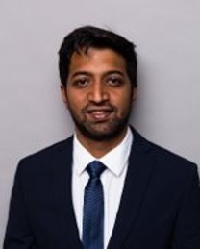
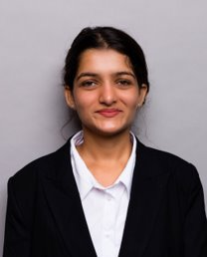
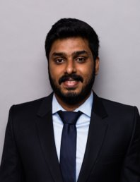
Meet The Team
Niyathi Aiella
Sohini Chakraborty
Jason Crawford
Shreyas Joshi
Mahima Kriplani
Amal Tom

Slide 3
EXECUTIVE SUMMARY
Unstructured nature of job listings on Craigslist
Lack of information about the nature of job listings
No recommendations to recruiters for enhancement of job descriptions.
Problem Definition​
Utilize unstructured data to give a specific title to each job listing.
Provide recommendations to the recruiter to add missing features to the add posting.
Improve the listing to search results
Business Objectives
SOLUTION BLOCKS
Data Extraction
Data Cleaning
Topic Modeling
ML Models
Insights
Scraped data for job descriptions:​
~600 under ‘education’ ​
~1500 under ‘food/restaurant’​
​
Tried Kmeans, LDA and HDP to form topic clusters across both job the​ Categories.​
Split data into train : test in the ratio of 75:25.
Validated model performance using data mining techniques
Proper titles to the job
Descriptions can be leveraged
to increase website traffic.
Cleaned the extracted data using ​​ NLP techniques​​.
OUTCOMES
Job Description
Assigned Topic
QR Code Link to This Post Noah's Ark Day Care is a Christian daycare that is currently accepting applications for multiple positions. Day Care Teachers: Monday - Friday 7am - 4pm (Full Time) 9am-6pm (Full Time) 6am-12pm (Part Time) 11am-6pm (Part Time) 3pm-6pm (Part Time) Full Time Employees receive - PTO, Paid Holidays off, health insurance, dental insurance, life insurance, 401(k) matching. Part Time Employee's receive - PTO and 401(k) matching, Paid Holidays off. We also offer 75% off child tuition to our employees. No experience needed. We offer on the job training. Please call to set up a time to come in and fill out an application and have an interview. 314-487-8507
Pre-School/Pre-Primary
Scraped data for job descriptions:
~600 under ‘education’
~1500 under ‘food/restaurant’
Cleaned the extracted data using
NLP techniques
Split data into train : test in the ratio of 75:25.
Validated model performance using data mining techniques.
Proper titles to the job
Descriptions can be leveraged
to increase website traffic.
Scraped data for job descriptions:
~600 under ‘education’
~1500 under ‘food/restaurant’
Cleaned the extracted data using
NLP techniques
Scraped data for job descriptions:
~600 under ‘education’
~1500 under ‘food/restaurant’
Cleaned the extracted data using
NLP techniques
Split data into train : test in the ratio of 75:25.
Validated model performance using data mining techniques.
Scraped data for job descriptions:
~600 under ‘education’
~1500 under ‘food/restaurant’
Cleaned the extracted data using
NLP techniques
Split data into train : test in the ratio of 75:25.
Validated model performance using data mining techniques.

Slide 4

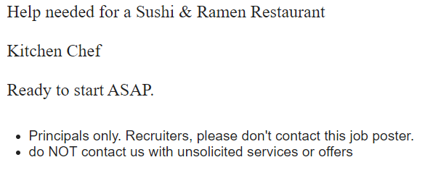
Craigslist Background
American classified advertisement website focusing on different domain​.
Jobs subsection is our area of interest.​
The Information present in job listings currently is vague and unstructured​.
We aim to improve the job listings in Education and Food/Beverage/Hospitalitydomain​​.

Slide 5
BUSINESS OBJECTIVES
Utilize unstructured data to give a specific title to each job listing. ​
Provide recommendations to the recruiter to add missing features to the add posting.
Improve the listing to search results​

Slide 6
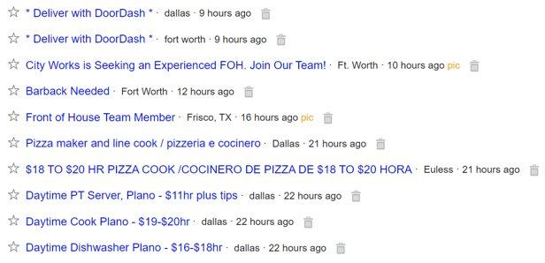
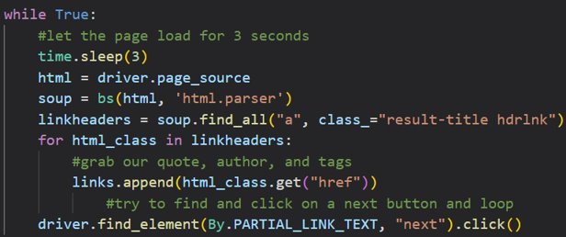
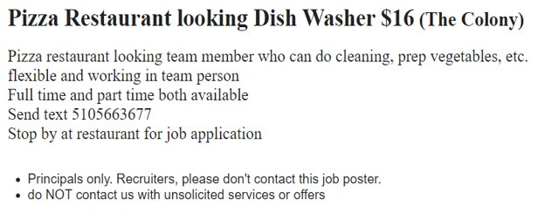
Data Scraping
Scraping done using Selenium and BeautifulSoup
Iterating through all links in a category for a variety of cities
Obtaining job description text from each link.
(~600 for education, ~1500 for food)
Major challenge: obtaining data en masse without being blocked by Craigslist

Slide 7
Finally, we were able to appeal to the Craigslist Gods XD

Slide 8
Data Cleaning
De duplicating
Tokenizing
Removing punctuations attached to words
Lowercasing, removing stop words + html tags punctuations
Removing single letters and numbers
Lemmatizing

Slide 9
Job Category : Education

Slide 10
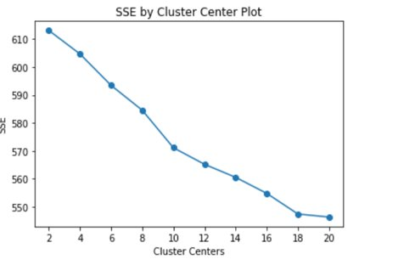
K Means Clustering Approach
Kmeans_model = MiniBatchKMeans(n_clusters=10,
init_size=1024, batch_size=2048,
random_state=100).fit(Tfidf_education)
Based on the elbow method, optimal number of clusters = 10. Top words in each cluster gave good results.
Topic 0: Pre-School/Pre-Primary
Topic 1: Special education
Topic 2: Substitute
Topic 3: Summer camp
Topic 4: Primary
Topic 5: High-School/College
Topic 6: Daycare
Topic 7: Vocational Training
Topic 8: Community/Non-Profit
Topic 9: Nanny/Caregiver

Slide 11
Topic Modeling
LDA
NMF
HDP
The number of topics are pre-defined.
Used for shorter length texts and tweets.
Used when the number of topics are not known apriori.
$129
$199
$259

Slide 12
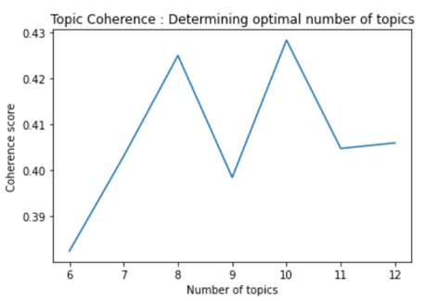
LDA Topic Modeling
lda_model_10topics = LdaModel(corpus=corpus,​
id2word=id2word,​
num_topics=10, ​
random_state=100,​
chunksize=100,​
passes=10)​
​
Based on the coherence score, optimal number of topics = 10​.
Topic 0: Community​
Topic 1: School​
Topic 2: Camp/Summer camp​
Topic 3: Special school​
Topic 4: Music/Other Vocational Courses​
Topic 5: School​
Topic 6: Pre-primary/Daycare​
Topic 7: High School/College​
Topic 8: Sports/Other Vocational Courses​
Topic 9: Nanny/Daycare​

Slide 13
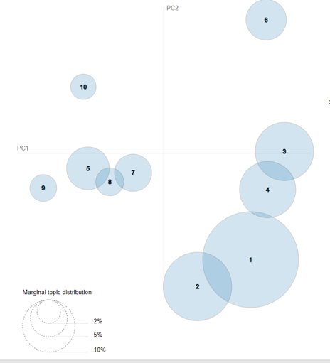
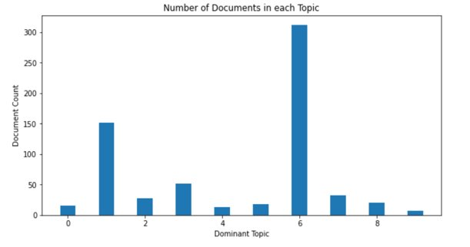
LDA Topic Visualization
Topic distribution
Inter-topic distance map

Slide 14
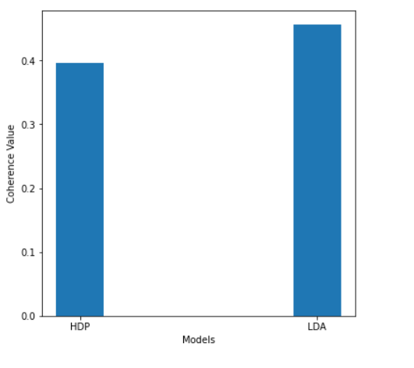
LDA vs. HDP
LDA model has a higher coherence score than HDP.

Slide 15

ML Model Accuracies
Classic
Advanced
Frontier
Linear Support Vector
Classifier
75%
85%
59%
Logit
BERT
57%
Decision Tree
55%
48%
Random Forest
Naïve Bayes
84%
Support Vector
Classifier

Slide 16
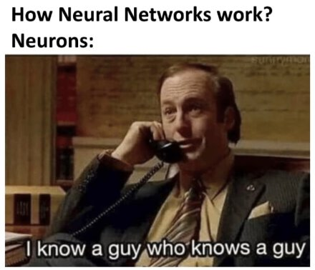
Neural Network and Deep Learning
The model we see
How it actually works!
Source – engati.com

Slide 17
ML Model Accuracies
Classic
Advanced
Frontier
Linear Support Vector
Classifier
75%
85%
59%
Logit
BERT
57%
Decision Tree
55%
48%
Random Forest
Naïve Bayes
84%
Support Vector
Classifier

Slide 18

Recommendation to Recruiters on Craigslist
Assigned the closest cluster and topic model to each job posting we have analyzed.
Cross checked the words in JD to top words in K- Means cluster and topic model.
If the words is not present it serves as a good keyword to be highlighted in the Job description.
Job Description Words
Topic Model Keywords
Top Cluster Keywords
Modify Job Description

Slide 19
Craiglist Recommendation Example
This is a great opportunity for someone who is passionate about childcare, enjoys working with children and is willing to put in the necessary hard work to be the best of the best. The Child Care Director will work closely with the management team to open the new academy, adapt our existing operations policies and procedures then implement programs that are both engaging and educational for the children in our care. Some key responsibilities include supervising employees and creating curriculum. With a Christian setting (in the church building), being part of the ministry to children is important.
Missing Key Words
Cluster
child', 'teacher', 'experience'
Topic Modelling
‘experience', 'candidate', 'time', 'please', 'position', 'language'''
Cluster and Topic Modelling
‘experience’

Slide 20
Job Category : Food/Beverage/Hospitality

Slide 21
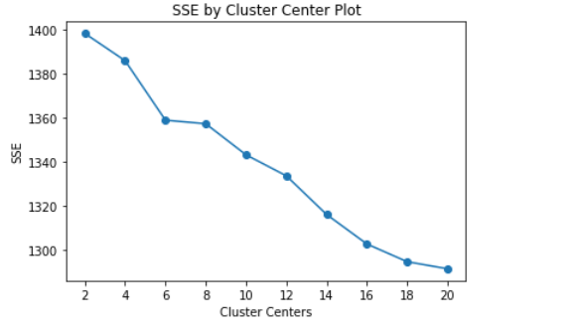
K Means Clustering Approach
Kmeans_model = MiniBatchKMeans(n_clusters=10,
init_size=1024, batch_size=2048,
random_state=100).fit(Tfidf_education)
Based on the elbow method, optimal number of clusters = 10. Top words in each cluster gave good results.
Topic 0: Part-time for Specific Days
Topic 1: Chef/Kitchen Staff
Topic 2: Server
Topic 3: Manager(event/restaurant)
Topic 4: Outside city/Highway restaurant job
Topic 5: Food delivery
Topic 6: Cook/bartender
Topic 7: Part-time server
Topic 8: Mexican restaurant
Topic 9: Employee

Slide 22

ML Model Accuracies
Advanced
Classic
Frontier
89%
Linear Support Vector
Classifier
83%
70%
Logit
65%
BERT
Decision Tree
64%
58%
Random Forest
Naïve Bayes
91%
Support Vector
Classifier

Slide 23
Business Insights & Future Scope
Match the relevant resumes to respective
job posting categories.
Get market insights on specific job roles, understand job demand and make compensation suggestions to the job postings
Improve the scope of key word recommendation to the resume of the applicants as well
Improve ad posting by showcasing relevant ads to both recruiters and candidates based on their data

Slide 24
THANK YOU

